Slide 1
THEORY OF CONSTRAINTS &
DRUM – BUFFER - ROPE
Presented By: Brad Detchevery
Concept: Elijah Goldratt
Memories 2004

Slide 2
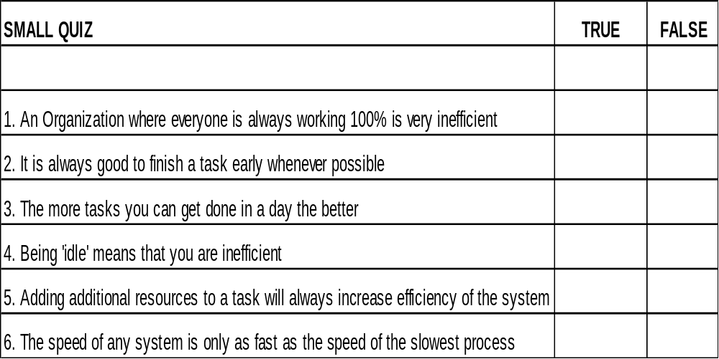
INTRO QUESTIONS

Slide 3


THE THEORY
Any system (no matter how complex) can be viewed as a link of tasks contributing to a bigger goal

Slide 4
THE THEORY
Work Center A
5 units/month
Work Center B
10 units/month
Work Center C
3 units/month
Work Center D
8 units/month
What is the maximum number of units the system can produce?
By how much could this be improved if Work Center A was doubled?
By how much could this be improved if Work Center C increased by 1.
What is the effect on the system if Work Center A could only manage 4 units/month
What is the effect on the system if Work Center B can only manage 2unit/month
What is the effect on the system if Work Center D can only manage 1 unit/month?

Slide 5
THE THEORY
The speed at which the system can produce is limited by the slowest link.
Work Center A
6 units/month
Work Center B
10 units/month
Work Center C
3 units/month
Work Center D
8 units/month

Slide 6
CONCEPTS
Work Center A
5 units/month
Work Center B
10 units / month
Work Center C
3 units/month
Work Center D
8 units/month
CONSTRAINT: Any resource whose capacity is less than or equal to the demand placed upon it. (aka Bottleneck)‏
NON-CONSTAINT: Any resources whose capacity is greater than the demand placed upon it.
On a constraint whatever time is available is still less than capacity so it can not afford not to be working (1 hour lost at constraint = 1 hour lost whole system)‏
Offloading the work of a bottleneck increases the amount of work that can be done by the bottleneck therefore increases the entire system
If items can be rejected before entering bottleneck the bottleneck can spend more time working on inventory that contributes to throughput. If the bottleneck works on a item that could have been rejected, this time was lost in the system and cannot be regained.

Slide 7
CONCEPTS
Work Center A
5 units/month
Work Center B
10 units / month
Work Center C
3 units / month
Work Center D
8 units / month
10 units/month
You can’t look at optimizing only certain sections. It is necessary to look at optimizing the whole system.
  Eg: What happens if we double Work Center A?
Work center A can now process 10 units/month
Entire system can still only process 3 units/month
However, Work Center C now has MORE inventory piling up in front of it.
Each week more and more inventory piles up on Work Center C, which can never get out of the system (stuck in WIP).
If Work Center C has 90 units waiting to be processed from all inventory in the system. What can we do to improve our productivity?

Slide 8
SUMMARY
Material Release
5 units/week
Assembly
10 units / month
Test/Calibrate
3 units / month
ATP
8 units/month
5 units/month
  To increase the productivity of a system, only focus on increasing the productivity of the constraints
  Increasing productivity at non-constraints ties up inventory in the system
  Non-constraints should move at a rate which supports the constraint even if they could do more.
  RELEASSE Material at a rate that supports the CONSTRAINT
  Schedule ORDERS by scheduling the CONSTRAINT

Slide 9
DRUM BUFFER ROPE
DRUM = A schedule for the constraint based on demand.
BUFFER = The time provided for parts to reach a PROTECTED AREA
ROPE = A schedule for releasing Materials
PROTECTED AREAS = THE DRUM, THE DUE DATES, ASSEMBLIES OF CONSTRAINTS & NON-CONSTRAINTS

Slide 10
DRUM BUFFER ROPE
WHY DO WE USE A BUFFER ?
  Capacity is an average, it is subject to fluctuation. Eg; WC#1 might do 5/month in a typical month, but problems might only allow 3/month out one month, or a really good month might get 10/month out.
  The BUFFER is a PROTECTOR for fluctuations.

Slide 11
SIMPLE
DEMONSTRATION

Slide 12
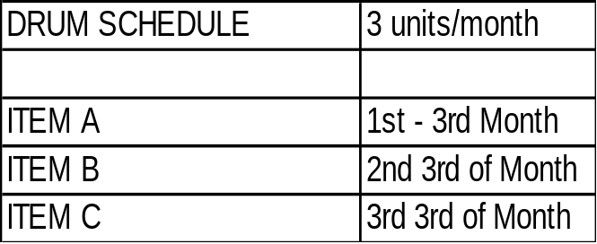
Work Center A
5 units/month
Work Center B
10 units / month
DRUM
3 units/month
Work Center D
8 units/month
BUFFER
Number (eg: 2) after
Which the rope will
No longer
Release inventory

Slide 13
QUESTIONS AGAIN

Slide 14
WHAT CAN YOU CONCLUDE ABOUT OVERTIME?
If you work extra on a task, and that task is a constraint, is there value in the overtime?
What if the task is not the constraint?
What if the task is not a constraint, the demand is ’20’ and the real constraint can only handle ’10’ ? SMALLER BATCH SIZE?

Slide 15
WHAT CAN YOU CONCLUDE ABOUT OVERTIME?
Questions to ask when putting in extra time
  If I want to get ahead putting in extra time what tasks should I pick to spend extra time on?
  If I am working extra time to complete a task, is this task REALLY the constraint ?
  If I am working A LOT of overtime on a lot of tasks (BIG TO-DO LIST), and I am the constraint, do the non-constraints produce at a rate that supports me?
  If I am a constraint, are solutions being examined to offload this work?

